Slide 1

BUSINESS INTELLIGANCE
MICROSOFT POWER BI PROJECT
Presented By
Aniruddha Deshmukh

Slide 2
Introduction to Data
The data of US Supplier “East Shore Supper Shop” Deals With the Technology ,Furniture's , Office Appliances .
The data is presented in an Excel format and includes information on customer areas and product purchases. The purpose of this analysis is to gain insights into the performance of the company and identify areas for improvement.
The data shows the different data are as follow
Customer id ,Area , Product , Rate , Discount , Profit ,
Date of Purchase ,Sub Type Of Product

Slide 3
NEED TO KNOW
What is the total sale ?
What is the profit we gain in year 2020?
Which are the top customers having highest purchase rate?
Show the Area wise performance.

Slide 4
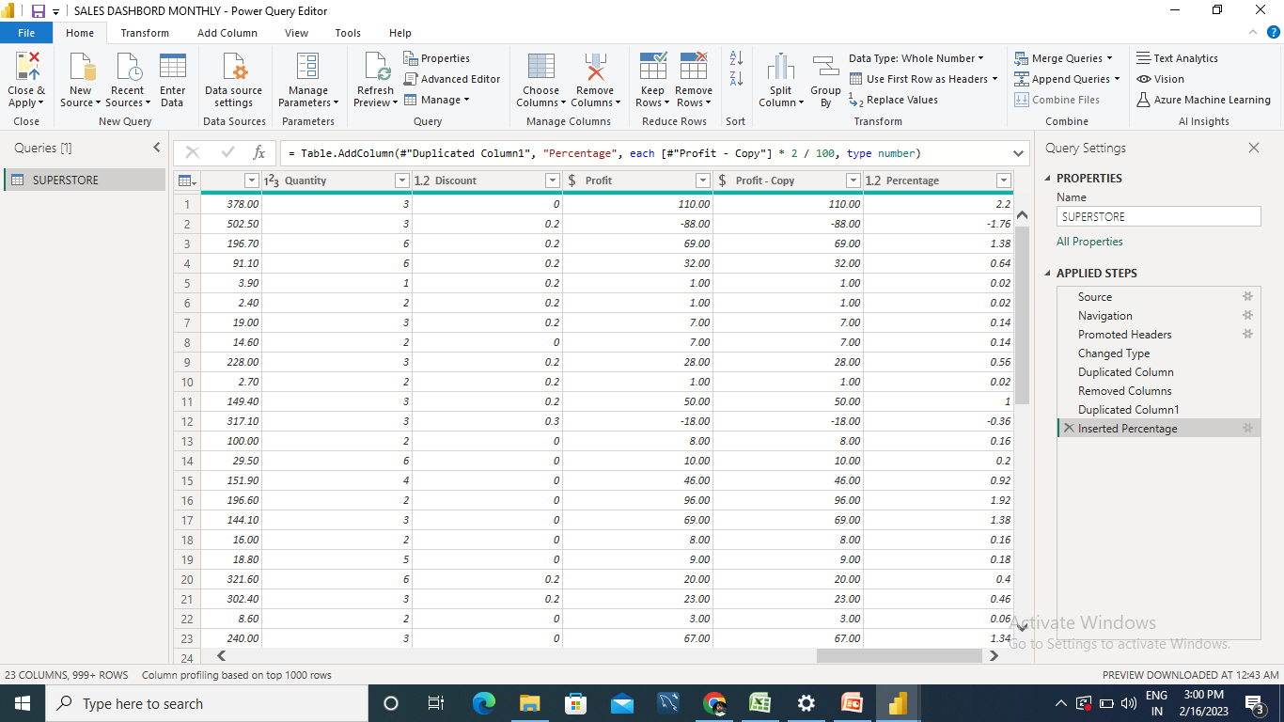
DATA EXECUTION
DATA IMPORT IN POWER QUERY
CHECK THE DATA WEATHER HAVING FORMATS, VALUES ,HEADERS ,ERRORS.
CREATING NEW ENTITY IF
REQUIRE.

Slide 5
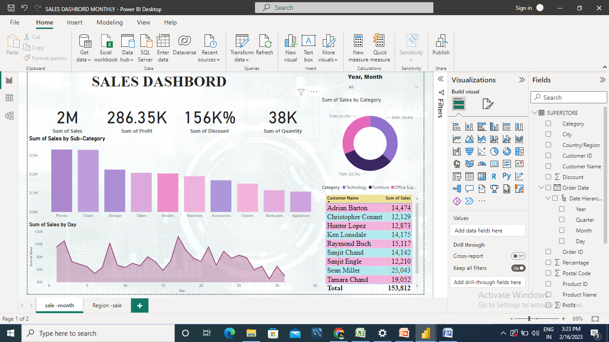
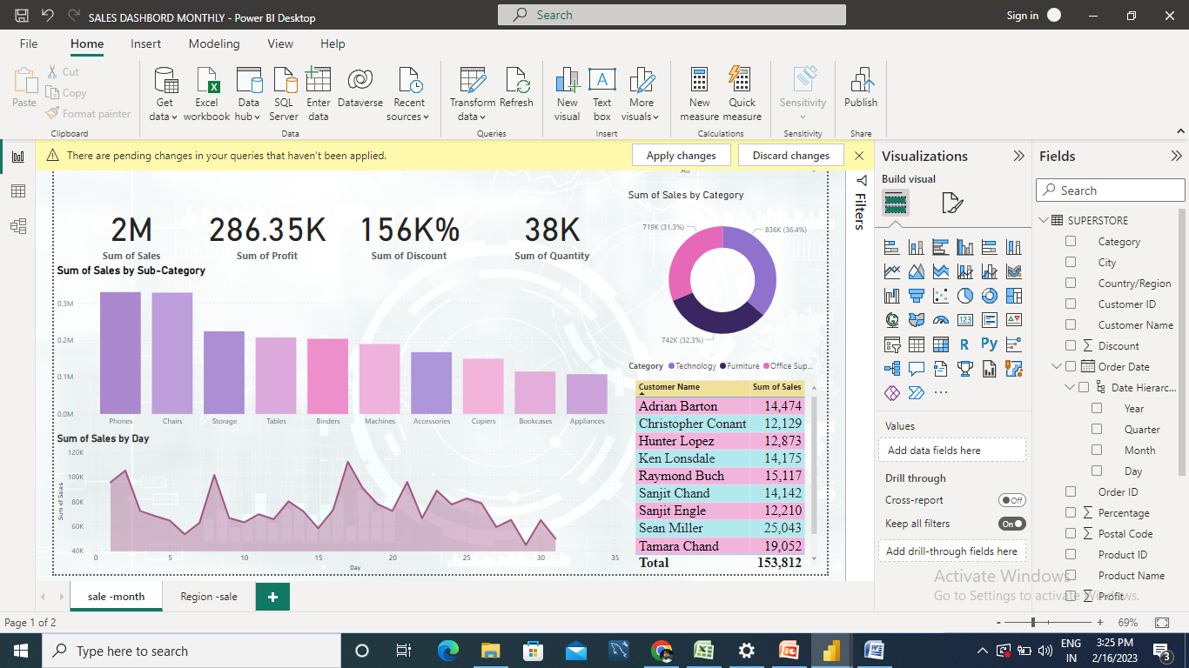

DATA VISULISATION
DATA IS PRESENT IN THE FORMS
CHARTS
SLICER
TABLES
MAPS

Slide 6

ADD MEASURE
TABLE FORMAT- DATA TO BE IN
REQUIRE FORMATY

Slide 7
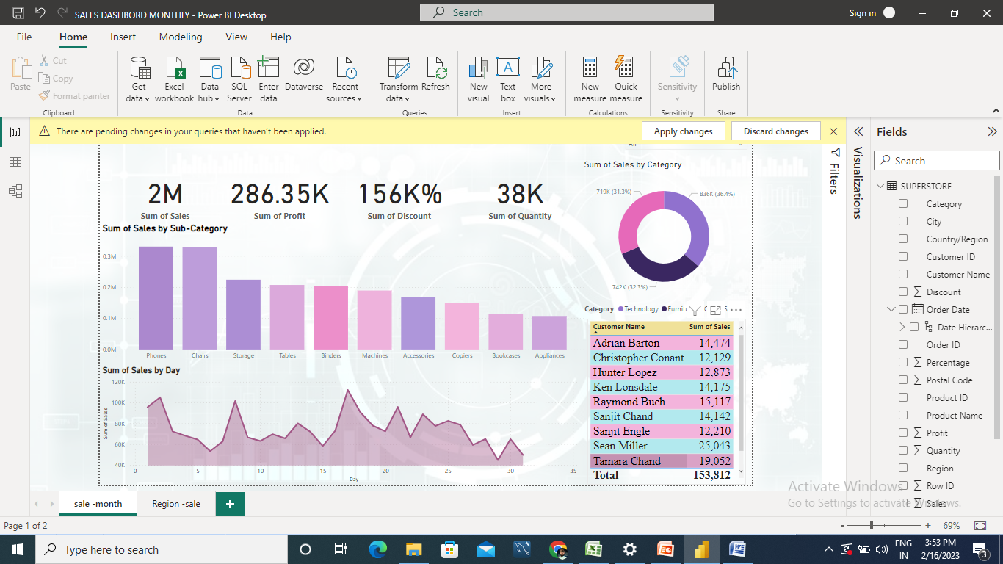
DASHBOARD - SALES

Slide 8
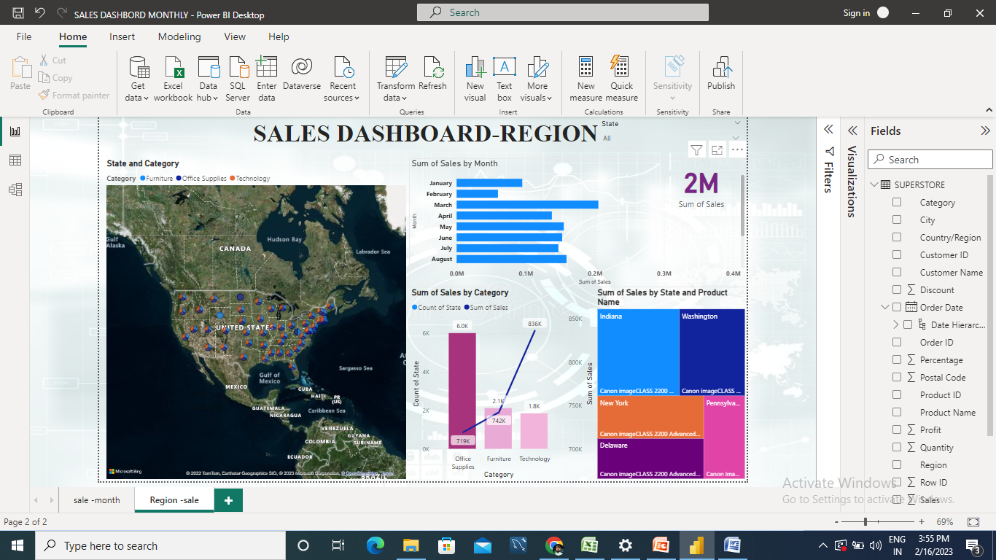
DASHBOARD -REGION

Slide 9
CONCLUSION
An analysis of the sales data for Super shop has provided valuable insights into the performance of the business. Through the process of cleaning and organizing the data, we were able to calculate key metrics such as total sales, average order value, and customer lifetime value.
By seeing the report we know that where our sale is going up and down like in few month the sale of furniture is going down.
Product most purchasing areas and the daily customers that we have to maintain.

Slide 10
THANK YOU

